Slide 1
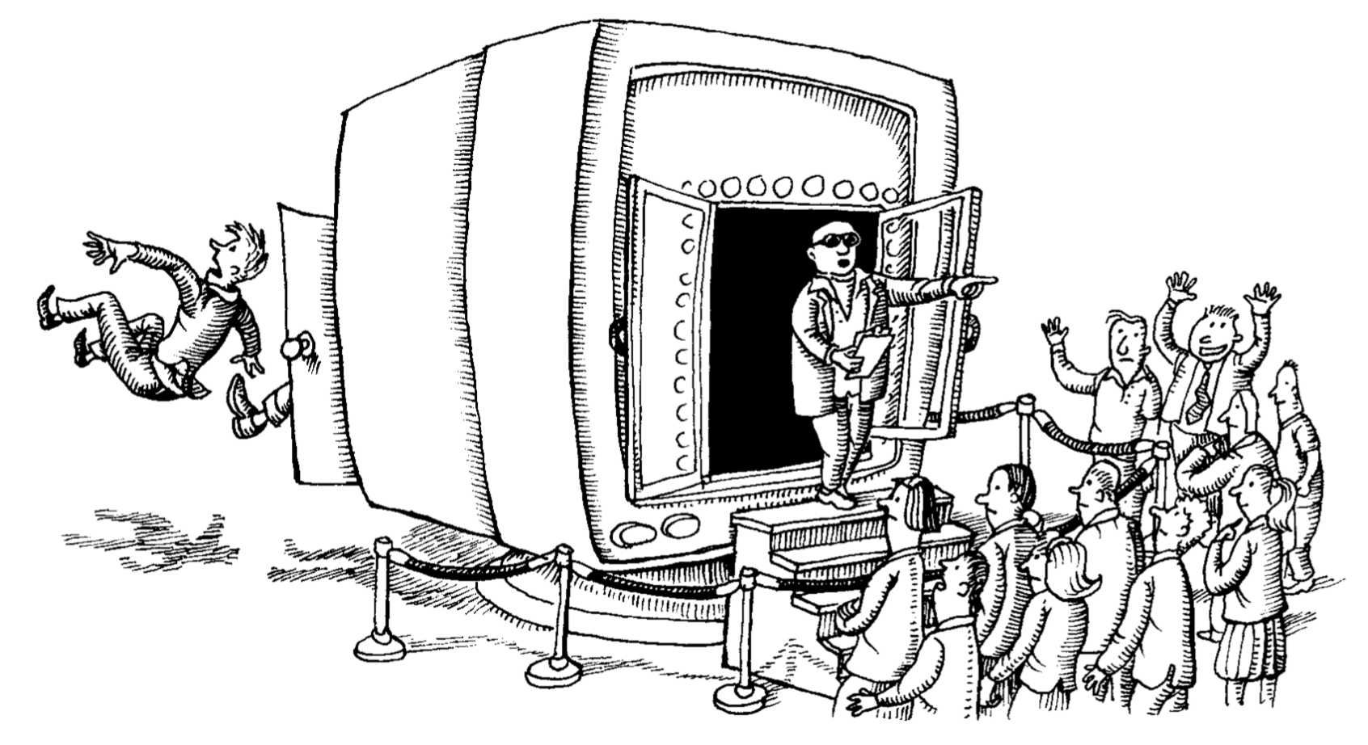
User Management

Slide 2
What is a User?
At its core, a user is an unsigned 32-bit integer value (the UID)
The system provides an API abstraction for login services to retrieve user information from user backends
The functions getpwuid() and getpwnam() allow you to lookup info via UID or login name, respectively
This allows for the creation of new login services that can interface with existing user backends and vice-versa
The functions return a record the login name, UID, GID, password hash, home directory, and shell program (and a few other things)

Slide 3
How Login Works
When a user logs in, the following steps happen
The user provides their login name and password
The login service (windows server, login, getty, etc.) makes a call to getpwnam() supplying the login name
The getpwnam() returns the record for the given login name from a user backend (passwd file, LDAP, Windows AD, etc.)
The login service checks the hashed input password against the hash stored in the returned record
If they match, the user is put into the home directory and attached to the shell specified in the record

Slide 4
The /etc/passwd File
Text file which represents the original user backend and contains the following information
Login name
Encrypted password placeholder
UID number
Default GID number
Optional GECOS information
Home directory
Login shell
Notes:
GECOS stands for the General Electric Comprehensive Operating System and was a set of fields used in that OS which typically have full name, office, extension, home phone

Slide 5
User Rules
Each user must have a unique UID, most user addition systems handle this automatically
UIDs for users should be the same across the entire fleet.
For small fleets this coordination can be accomplished by allocating groups of UIDs to different teams to distribute as necessary
For large fleets specific user backends should be used to guarantee uniqueness and coordinate UIDs across the fleet
Don’t recycle UIDs, even when the users associated with them are removed from the system. This prevents confusion when backups restore files that belonged to removed users

Slide 6
Home Directory & Login Shell
Home directory is the default directory the user will be redirected to when they log in and holds account specific customizations
Shell aliases, environmental variables, SSH keys, server fingerprints, etc.
If a home directory is unavailable when logging in (for instance it is a NFS that isn’t currently connected) the login may dump the user into the base directory or disallow the login (system specific)
Login shell is typically a command interpreter, but can technically be any program

Slide 7
The /etc/group File
Lists all the systems groups and group members with the following fields:
Group name
Encrypted password or placeholder
GID number
List of members, separated by commas (no spaces)
Group passwords can be set to allow users to join a group themselves (!)
To increase security, users are typically given their own individual group and then optionally put into other groups for file sharing (!)
You can also use groups for sharing permissions such as adding users to an admin group and giving that group root permissions in the sudoers file (!)
GIDs should also be consistent across the fleet, with increased difficulty do to different OS using different GIDs for the same service groups
Notes:
Group joining password are another attack vector for someone to use, because a badly set password or misplaced password could allow someone to gain additional powers
Users are given their own groups so that their default permissions are not to have shared files, increasing security by decreasing the likelyhood that a badly set permission will cause a security hole
Using groups to administer sudo right requires additional attention as groups are determined on a per-machine basis. This is best done when you have other systems like LDAP or WIndows AD to administer user and group permissions

Slide 8
Password Evolution
Originally systems encrypted user passwords with DES and held the hash in the passwd file directly
As computing power increased, those passwords became trivial to crack
Systems then moved to MD5 cryptography and hidden password hashes
Weakness have been discovered in the MD5 cryptography scheme, so systems have switched to salted SHA-512 cryptography as the default password hashing scheme
All UNIX versions provide a method for changing the encryption scheme and you can additionally use PAM to add additional authentication methods

Slide 9
The /etc/shadow File
File only viewable by root which which serves as an extension to the /etc/passwd file containing password centric information such as
Login in
Encrypted password
Date of last password change
Minimum number of days between password changes
Maximum number of days between password changes
Number of days in advance to warn users about password expiration
Days after password expiration that account is disabled
Account expiration date
Field reserved for future use which is currently always empty
The pwconv utility syncs the contents of the shadow and passwd files
Notes:
Only the bolded long in and encrypted password are required

Slide 10
Question What steps do you need to do to add a new user?

Slide 11
Manually Adding a User
Creating a user requires performing the following steps:
Have the new user sign your user agreement and policy statement
Edit the passwd and shadow files to define the user’s account
Add the user to the /etc/group file
Set an initial password
Create, chown, and chmod the user’s home directory
Configure roles and permissions
Copy default startup files to the user’s home directory
Verify that the account is set up correctly
Document the user’s contract information and account status
Notes:
The bolded steps are required

Slide 12
Scripts for Adding Users
Use the commands useradd, usermod, and userdel to perform these tasks for you in an automated (and configurable) fashion
There are two different configuration files
/etc/login.defs which is a file that is modified directly
Password aging, choice of encryption algorithms, location of mail spool files, preferred ranges of UIDs and GIDs
/etc/default/useradd which is modified using the useradd function
Location of home directories, default shell for new users
There are additional useradd flags for modifying its function over the configs including setting groups, GECOS information, etc.
Notes:
The general defaults are to create a new user with an individual group, use SHA-512 encryption, and populate the new user’s home directories with startup files from /etc/skel

Slide 13
Manually Removing a User
Removing a user requires performing the following steps:
Remove the user from any local user databases (or phone lists)
Remove the user from mail aliases database (or add forwarding address)
Remove the user’s crontab file and any pending at jobs or print jobs
Kill any of the user’s processes that are still running
Remove the user from the passwd, shadow, and group files
Remove the user’s home directory
Remove the user’s mail spool (only for local mail servers)
Delete or transfer ownership of any mailing lists run by the delete user
Remember that files can have shared permissions, so its best to move or backup user files before removing them
Notes:
The at function schedules jobs to be run at a specific time

Slide 14
Scripts for Removing and Locking Users
Use the userdel command to remove users from the system, although different Linux variants offer additional and more powerful versions
You may need to lock a users account, perhaps because you suspect it of being compromised, which you can do by appending a * or ! before their password in the shadow file or by using usermod -L (to lock) and usermod -U (to unlock) which accomplishes the same thing
This only causes the users login to fail, it may be more informative to replace the users shell with a program which prints why their account has been locked, however this will not disallow processes that ignore the shell

Slide 15
Centralized Account Management
Lightweight Directory Access Protocol (LDAP) is a database-like repository that stores user management and related data and servers as a central location for user information and coordination
Single sign-on (SSO) allows the user to authenticate once and multiple applications to utilize those credentials for validation (UCR’s CAS is an example of this system)
Identity and Access Management (IAM) represents systems for identifying, authenticating, and giving permissions to users and is generally implemented as a commercial system

Slide 16
Questions?

Slide 17
Additional Resources
getpwnam man page

